Slide 1




Decision Trees and Random Forests

Slide 2
A decision tree asks a question and classifies the person based on the answer
A Person likes Pie Charts
True
False
It can be categorical

Slide 3
I use pie charts > 50% of the time
True
False
Or it can be numerical

Slide 4
I love pie charts
True
I like pie charts
True
False
Or it can be ranked

Slide 5
Labelling Decision Trees
Root or root node
Internal Node
Internal Node
Leaf Node
Leaf Node
Leaf Node
Leaf Node

Slide 6
Tables to Trees
Likes Cats | Likes Violin Charts | Likes 3D Graphs | Likes Pie Charts
Yes | Yes | Yes | Yes
No | Yes | Yes | Yes
Yes | No | Yes | Yes
No | No | No | Yes
Etc.. | Etc.. | Etc.. | Etc..
Notes:
We want to look at whether a person like cats or violin charts or 3D charts can predict whether someone likes pie charts – we have a set of test data to build the model.
But which variable do we look at first. To work this out we look at the results in each combination and determine the impurity of the leafs.

Slide 7
Tables to Trees
Likes Violin Charts
Likes Cats | Likes Violin Charts | Likes 3D Graphs | Likes Pie Charts
Yes | Yes | Yes | Yes
No | Yes | Yes | Yes
Yes | No | Yes | Yes
No | No | No | Yes
Etc.. | Etc.. | Etc.. | Etc..
Impurity Level of 0.434
Pie Charts
Yes | No
102 | 32
Pie Charts
Yes | No
64 | 119
Likes Cats
Likes 3d Graphs
Impurity Level of 0.421
Impurity Level of 0.479
Pie Charts
Yes | No
26 | 78
Pie Charts
Yes | No
86 | 71
Pie Charts
Yes | No
97 | 23
Pie Charts
Yes | No
17 | 57
Notes:
We want to look at whether a person like cats or violin charts or 3D charts can predict whether someone likes pie charts
But which variable do we look at first. To work this out we look at the results in each combination and determine the impurity of the leafs.
The impurity is worked out by looking at the proportions of true/falses in each leaf and using a weighted mean to compare with other leaves. The combination with the lowest impurity becomes the root of the tree diagram.

Slide 8
Decision Trees are used to predict answers to questions. Impurity calculations tells us in which order to ask the questions.
Likes cats
Like 3d Graphs
Likes Violin Charts
Likes Pie Charts
Likes Pie Charts
Does not like Pie Charts
Does not like Pie Charts
Likes Pie Charts
Does not like Pie Charts
Likes Pie Charts
Does not like Pie Charts
Notes:
Decision trees look simple to use and explain but their simplicity is also their downfall – scale can cause problems and a small change in the data can completely change the tree and the model

Slide 9
Random Decision Forests
Notes:
Decision trees can have problems and are not sensitive to scale – a small change in the data can have a big impact on the model. Low predictive power, weak learner
Decision trees can be replicated many times using bootstrapping and built up into a random decision forest

Slide 10
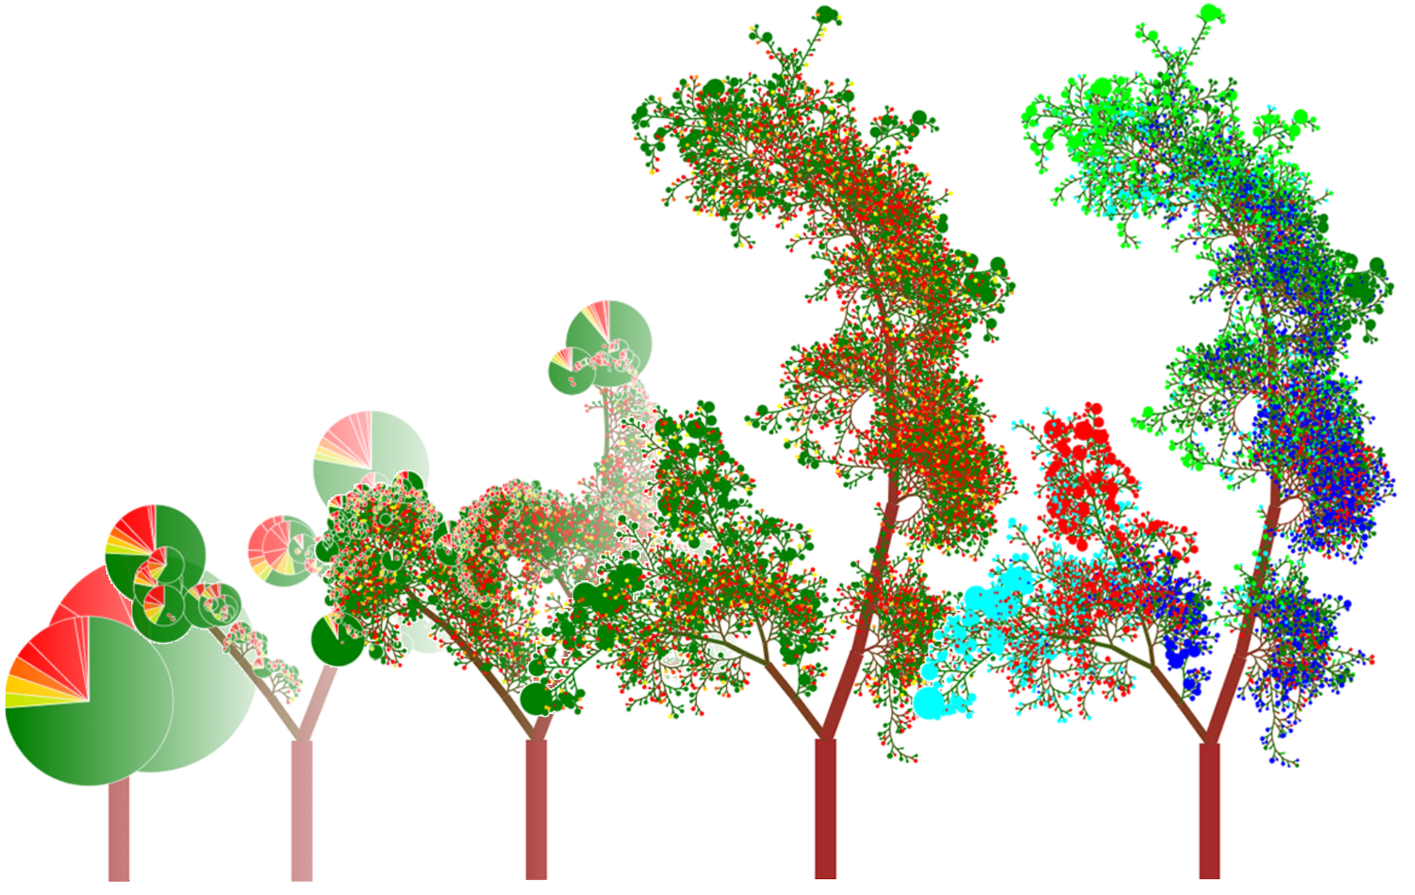
Random decision forests correct for decision trees' habit of overfitting to their training set
We can move from clunky pie charts to beautiful forests
Image from : http://www.rhaensch.de/rfvis.html
Notes:
Running a large number of decision trees creates a forest for the model. The data is trained by bootstrapping.
Results with the most predictions become the overall prediction

